Slide 1
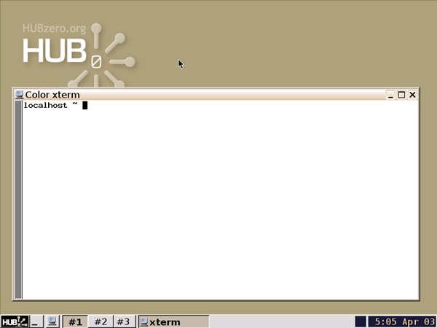
Using Simulation Workspaces
Derrick Kearney
HUBzero® Platform for Scientific Collaboration
Purdue University
Original slides by Michael McLennan
This work licensed under
Creative Commons
See license online:
by-nc-sa/3.0

Slide 2
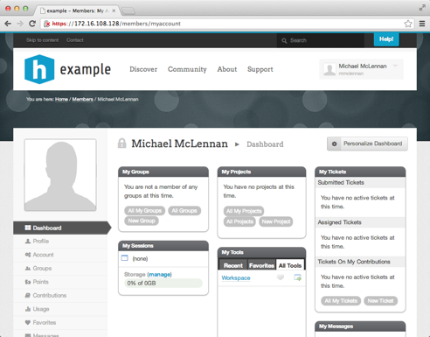
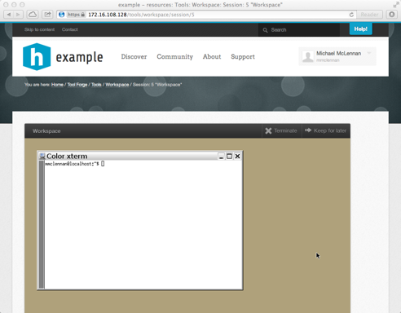
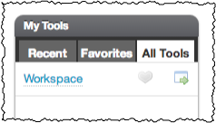
Launching workspaces
Find it on your dashboard:
Success!

Slide 3
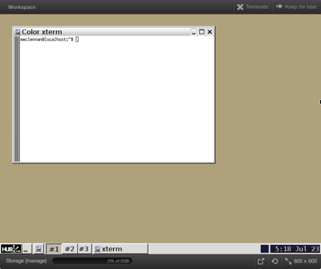





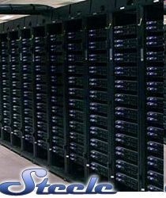

What is a workspace?
Full-featured Linux desktop
For tool developers
For researchers
Accessible from any web browser
Still running after you close your browser
Access to computational clusters
File storage provided by the hub
local
clusters
File server

Slide 4
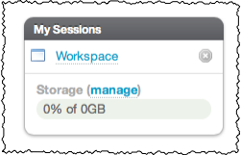
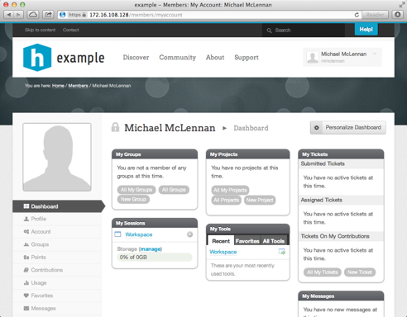
Accessing running workspaces
Close the browser
Still running, and listed under “my sessions”

Slide 5
Closing workspaces
Click on “Terminate”
Click here to terminate

Slide 6
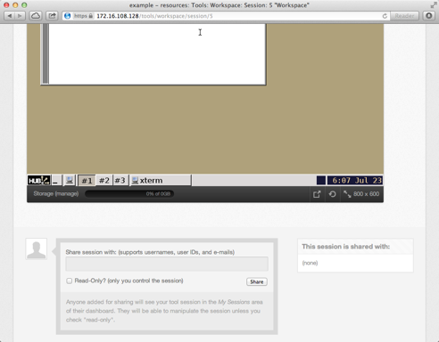

Resize the screen

Slide 7


Refresh the screen
If screen looks ragged,
click to refresh

Slide 8

Pop out as a separate window

Slide 9
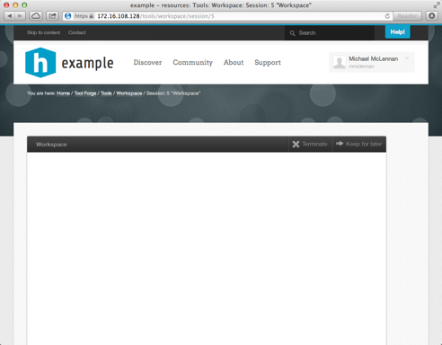
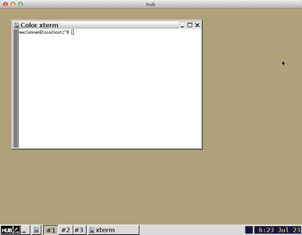
Pop out as a separate window
This area goes blank.
Closing window also
closes pop-up.
Click button again
to pop back in

Slide 10
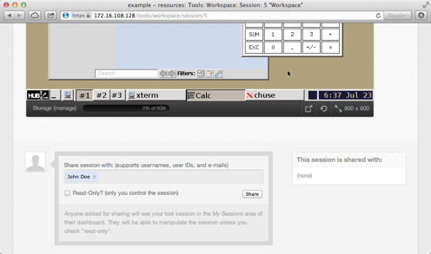

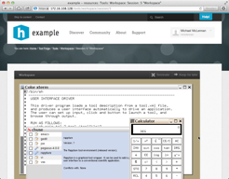
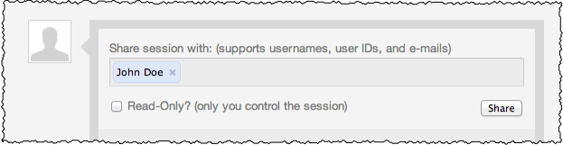


Share your screen
Share the session
with these people
johndoe
Check this box if
you don’t want to
share control

Slide 11
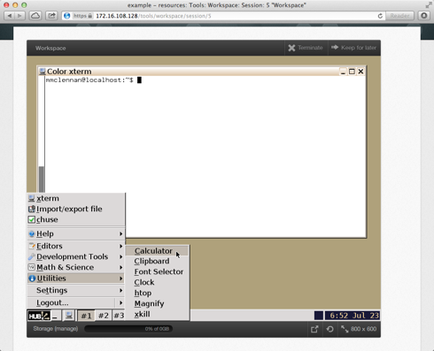
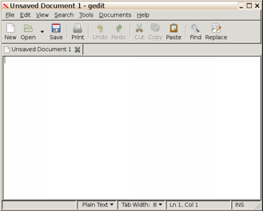
Explore the desktop
Editors:
geany
gedit
vim
emacs
“Start”
menu
New terminal
window

Slide 12
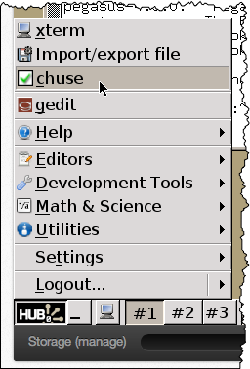
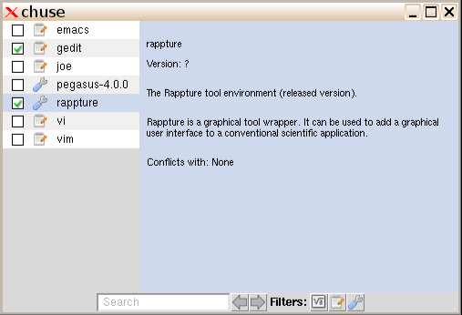
Choosing common utilities
Takes effect for the next new
terminal window that you open

Slide 13
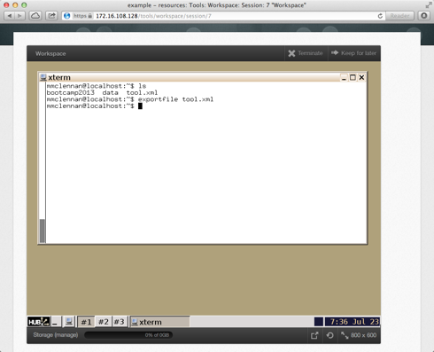
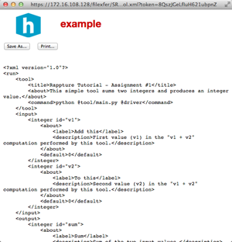
Downloading files
Easy way to download:
exportfile tool.xml

Slide 14
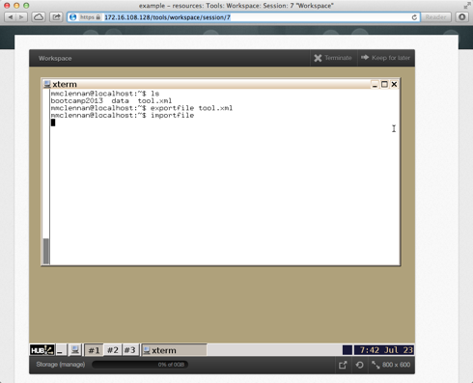
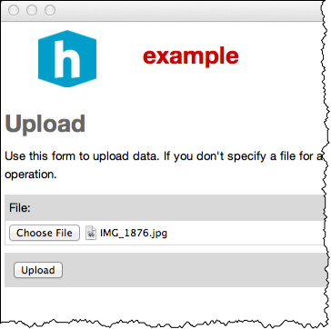

Uploading files
Easy way to upload:
importfile
IMG_1876.jpg

Slide 15

Direct access to your files
sftp yourlogin@yourhub.org
Use your login and password for the hub

